Slide 1
Salary Management System Database

Slide 2
Database Design
Identify the entities: Start by identifying the main entities.
Determine the relationships: Determine the relationships between the entities.
Normalize the data: Normalize the data to reduce redundancy and improve data integrity.
Implement the database: Implement the database by creating tables, defining relationships, and setting up constraints to ensure data integrity.

Slide 3
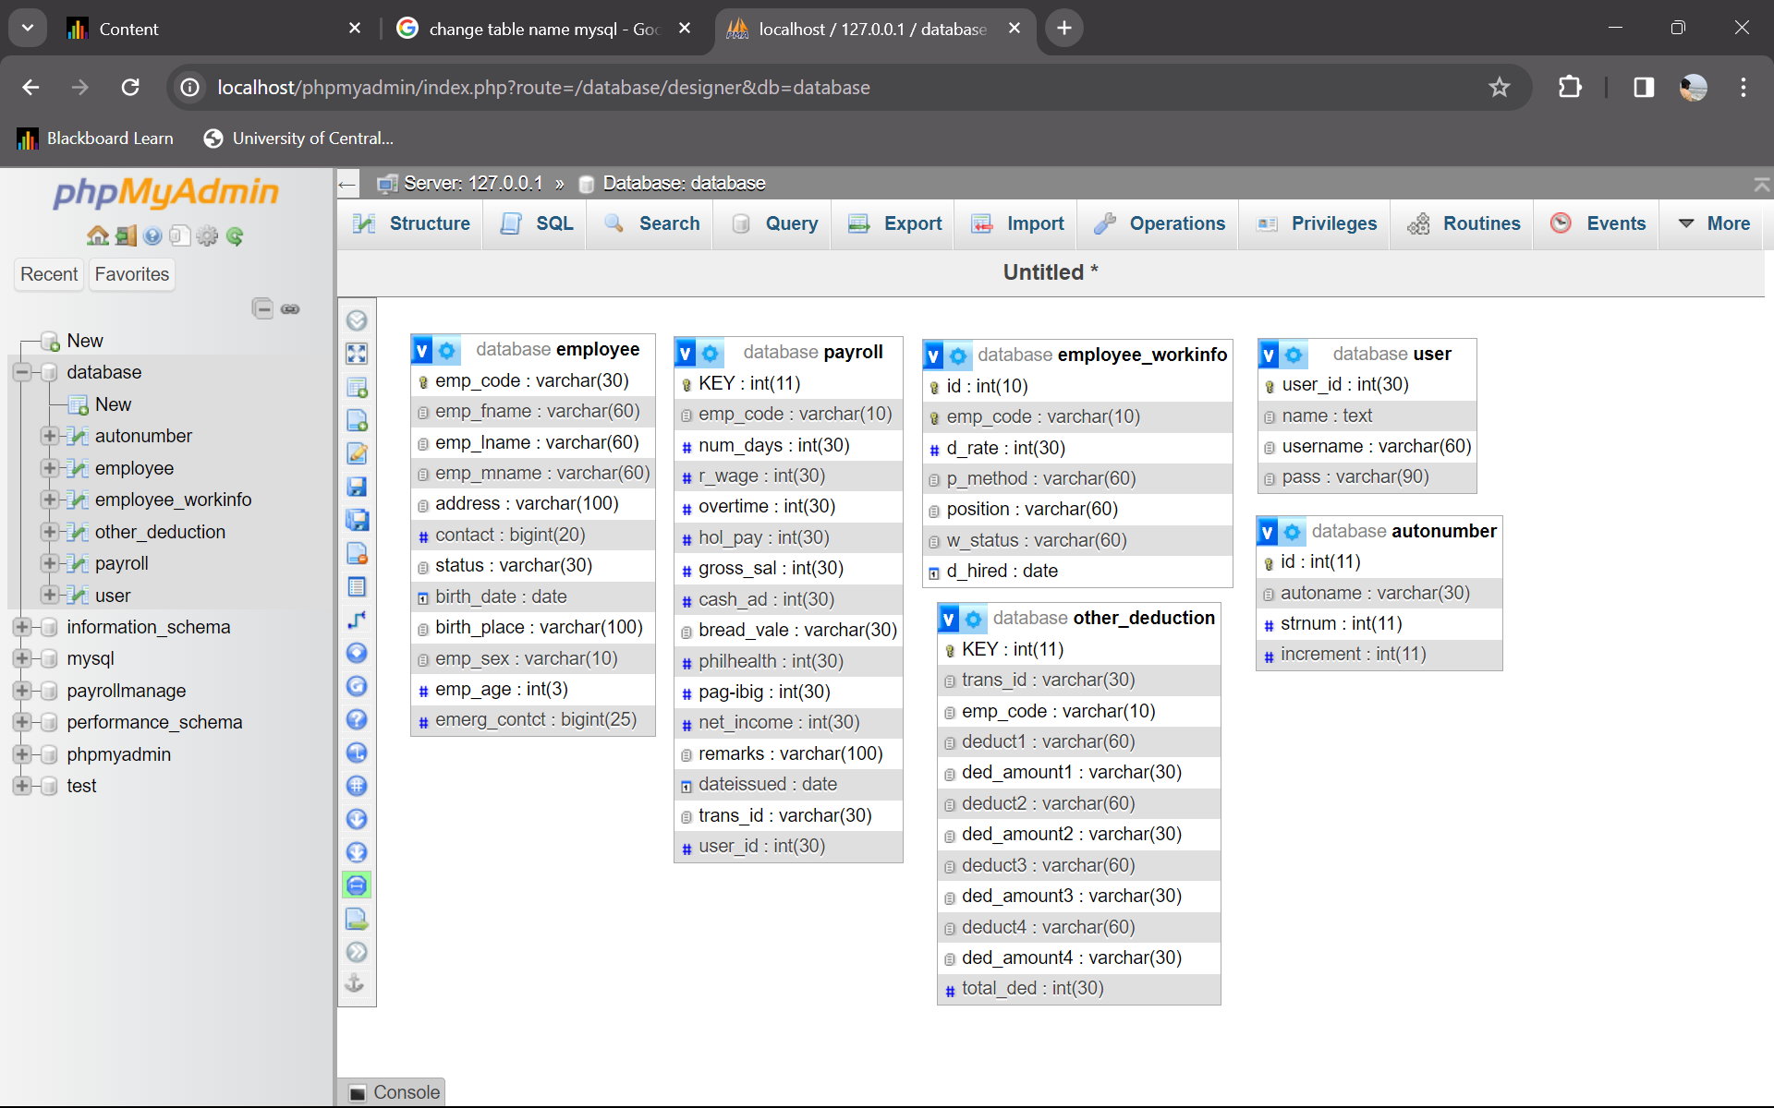
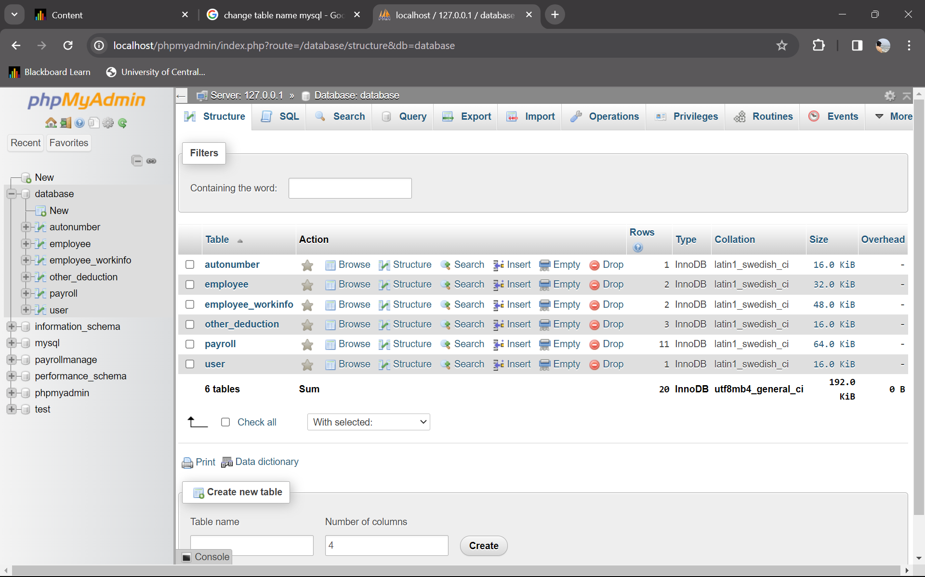
Database Screenshot

Slide 4
Back-end Implementation
C# is used for the backend logic of our Salary Management System. We used the .NET framework for building our application.
Our project generates an executable (.exe) file, which is the standalone application that users can run on their Windows computers.
our application is compatible with Windows 7 and above, which means it should work on a range of Windows operating systems, including Windows 7, Windows 8, Windows 10, and beyond.
Visual Studio 2022 is used as integrated development environment (IDE). Visual Studio is a powerful tool for developing Windows applications.

Slide 5
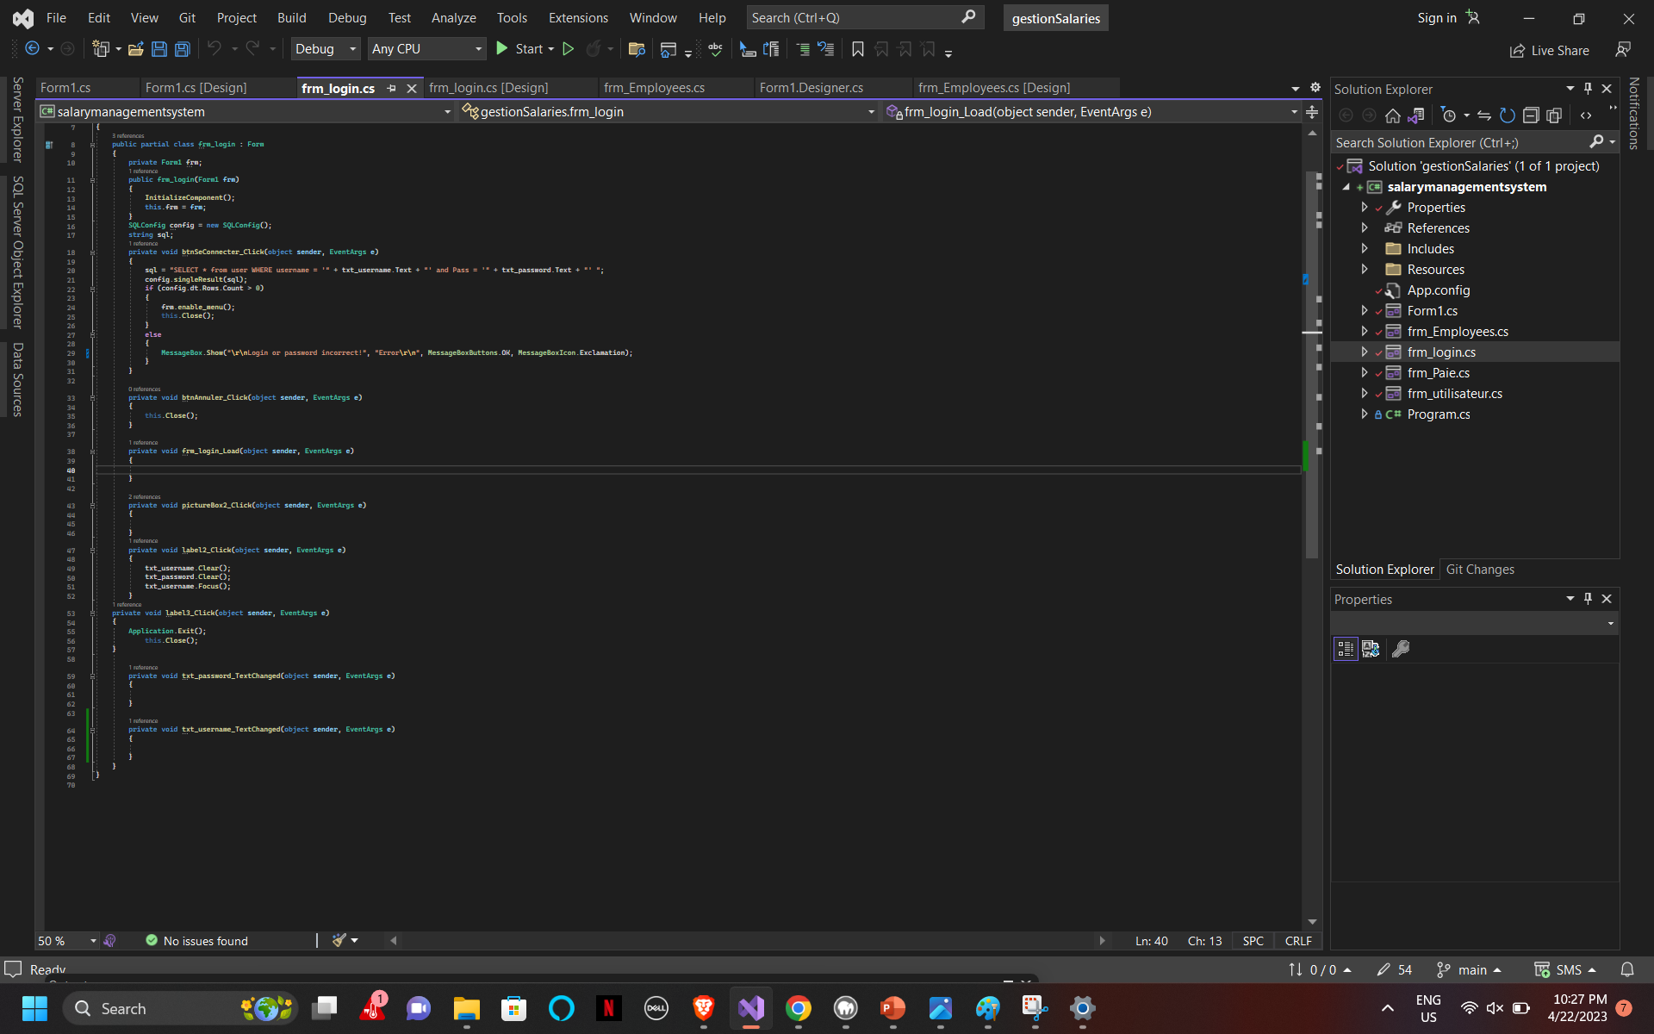
Back-end Code Screenshot

Slide 6
Front-end Implementation
We chose to create a Windows Forms application for the frontend.
Windows Forms is a popular framework for building desktop applications on the Windows platform.
It provides a graphical user interface(GUI) for our Salary Management System application.
Windows Forms in Visual Studio streamlines the development process, enabling us to design and code the frontend efficiently.
Windows Forms provides a scalable foundation for our application, allowing us to add new features and modules as our Salary Management System evolves.

Slide 7
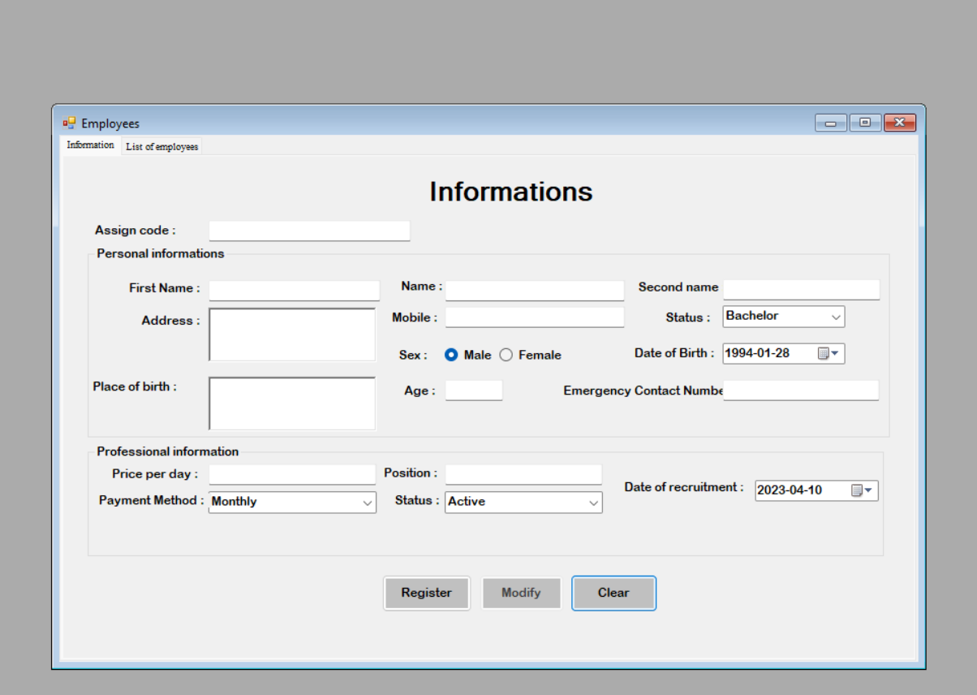
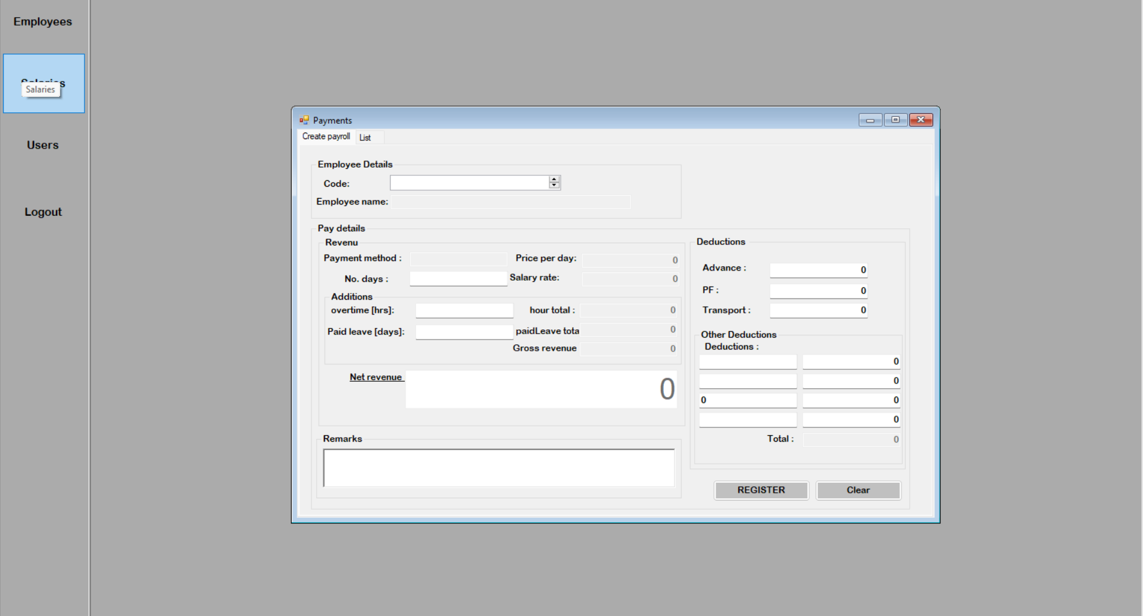
Front-end Screenshot

Slide 8
Project URL
Here is the project URL, from the given URL you can get the entire project source code.
There is the clear report of the Salary Management System.
It includes the executable .exe file and all the files related to the project.
URL: https://github.com/GudavallaiRamya/SalaryManagementSystem
IP: https://18.205.246.211/

Slide 9
TECHNICAL LEADER-SAI TEJASWI MANDOJI – 700758342 -Overseeing Design, Implementation and maintenance of Database ensuring Data Security, Performance Optimization and effective collaboration with team to meet user requirements.
DATABASE DEVELOPER-SURYABHAVANA ATMAKURI – 700741469-Database Design and Modeling and Query Optimization.
DATABASE DEVELOPER-REENA REDDY JAKKA - 700741594 - Database Monitoring and Ensuring Data Security and Integrity.
FRONTEND DEVELOPER-RAMYA SREE GUDAVALLI – 700759183-User Interface Design and Implementation.
BACKEND DEVELOPER-SAI VAMSHI THUMU – 700759298- Performance Optimization and Collaboration with Backend Developers and Designers.
BACKEND DEVELOPER-HARI KRISHNA YAKKANTI – 700756159 -Testing, Debugging and Code Management.

Slide 10
Self Effort
Project Overview: Developed a Salary Management System for organizations. Facilitates employee salary monitoring.
Team Leadership: Delegated Windows application development tasks to the team.
Technical Leadership: Oversaw database design, implementation, and maintenance. Ensured data security, performance optimization, and collaboration with the team to meet user requirements.
Project Impact: The project aids organizations in monitoring employee salaries.

